Slide 1

Fleet Management and Route Optimisation System
A comprehensive digital platform revolutionising how organisations manage vehicles, drivers, and operations

Slide 2
The Challenge: Fragmented Fleet Operations
Current Pain Points
Business Impact
Organisations operating multiple vehicles face significant operational challenges that impact efficiency and profitability.
These challenges translate directly into operational costs and service quality issues.
Inefficient resource usage across the fleet
No centralised visibility of vehicle and driver data
Delayed operations and missed deadlines
Limited real-time route analysis capabilities
Higher maintenance costs due to reactive repairs
Unclear insights into vehicle health and performance
Reduced customer satisfaction
Inefficient resource allocation and scheduling
The Solution: A unified digital platform that centralises fleet management, monitors driver availability, and calculates optimised travel routes — providing immediate operational benefits whilst laying groundwork for future AI-driven enhancements.

Slide 3
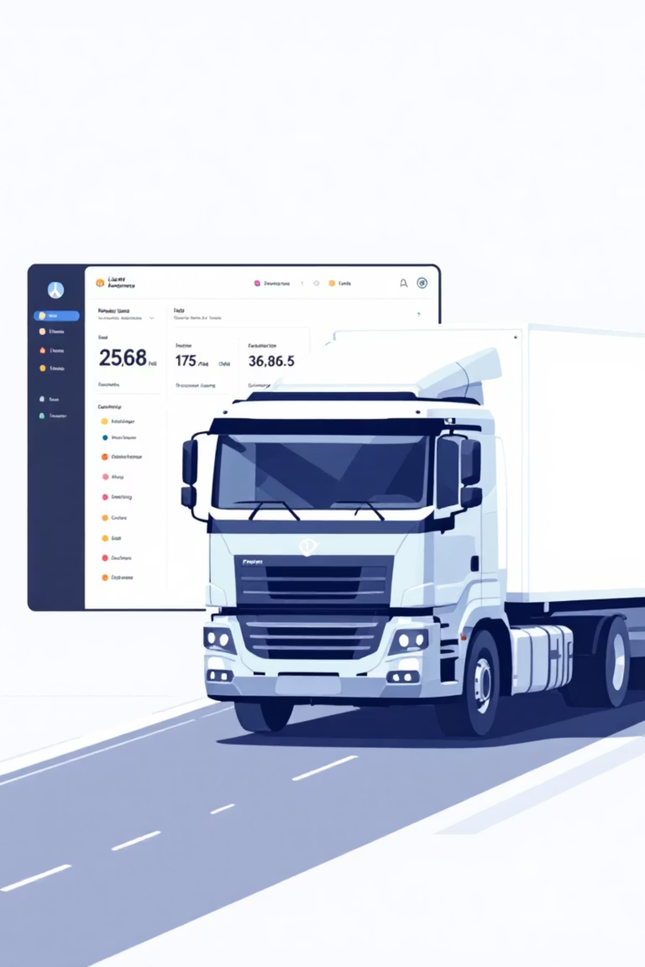




Our Solution: Intelligent Fleet Management
We've developed a web-based application that transforms fleet operations through centralised data management and visual analytics. The system provides immediate operational benefits whilst maintaining a modular architecture that supports future enhancements.
Centralised Dashboard
Unified view of all vehicle and driver data with real-time status monitoring
Route Calculation
Static distance computation between points, ready for dynamic traffic integration
Health Analytics
Comprehensive vehicle health tracking with visual performance indicators
Data Visualisation
Interactive charts and statistics for informed decision-making

Slide 4






Core Features Delivered
Vehicle Management
Driver Management
Comprehensive vehicle tracking system with detailed specifications, status monitoring, and maintenance history. Add, edit, and remove vehicles with complete data visibility.
Static driver database currently managed through Gmail-linked accounts. Foundation ready for role-based authentication and dynamic availability tracking.
Booking System
Vehicle Health Check
Manual trip booking using email authentication. Each booking captures driver assignment, vehicle allocation, and route details for comprehensive trip tracking.
Real-time monitoring of critical parameters including engine performance, brake condition, accelerator response, and fuel levels with visual status indicators.
Route Distance
Dashboard Analytics
Calculates direct path distance between selected points. Provides baseline routing data, prepared for future integration with live traffic and AI optimisation.
Interactive pie and bar charts displaying vehicle health distribution, driver status breakdown, and fleet performance metrics at a glance.

Slide 5

Technology Stack: Modern and Scalable
Built on industry-standard technologies ensuring reliability, performance, and future extensibility.
Frontend
Backend
Database
Visualisation
React.js
Spring Boot
MySQL
Recharts.js
Responsive, dynamic UI with reusable components. Ensures seamless user experience across devices with modern JavaScript framework.
Robust RESTful APIs for vehicle, driver, booking, and route modules. Java-based framework ensures enterprise-grade reliability.
Relational database storing all vehicle, driver, booking, and route details with optimised query performance.
Interactive graphical data representation. Transforms complex fleet data into intuitive visual insights.
Development Tools
Architecture Advantage: Modular design enables independent scaling of frontend and backend components, supporting future AI integration without system-wide refactoring.
IntelliJ IDEA for backend development
VS Code for frontend implementation
Postman for comprehensive API testing

Slide 6






Development Journey: From Concept to Deployment
Frontend Development
Created React components for Vehicle Manager, Driver Manager, Booking System, and Fleet Overview Dashboard. Implemented responsive design patterns and reusable component library.
Backend API Design
Defined RESTful endpoints using Spring Boot for CRUD operations across all modules. Implemented route distance calculation logic and data validation layers.
Database Integration
Configured MySQL schema for vehicles, drivers, bookings, and health metrics. Optimised relationships and indexes for query performance.
Data Visualisation
Integrated Recharts library for pie and bar charts on Fleet Overview dashboard. Created dynamic data binding for real-time updates.
Route Optimisation
Implemented static route distance calculation using direct path algorithms. Established foundation for future dynamic routing integration.
Integration Testing
Connected React frontend with Spring Boot APIs. Conducted comprehensive testing of data fetching, display, and user workflows across all modules.

Slide 7
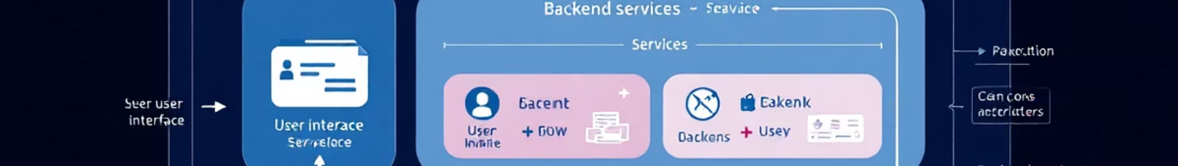
System Architecture Overview
User Access
Core Modules
Admin logs in and accesses the centralised Fleet Dashboard with full operational visibility
Vehicle Management, Driver Management, and Booking System provide comprehensive fleet control
Route Calculation
Data Analytics
Static optimisation module calculates distances and provides routing foundation
Charts and reports transform raw data into actionable business intelligence
The modular architecture ensures each component operates independently whilst maintaining seamless data flow. This design supports future enhancements including AI-driven routing, role-based authentication, and predictive maintenance without requiring system-wide restructuring.

Slide 8
Future Enhancements: The Road Ahead
AI-Powered Route Optimisation
1
Integration with Spring AI and LLM models to recommend dynamically optimised routes using contextual awareness, historical data patterns, and predictive analytics.
Dynamic Driver Availability
2
Real-time system enabling drivers to log in independently and mark their availability status. Automated scheduling based on driver location and shift patterns.
Role-Based Authentication
3
Secure multi-tier access control introducing worker, driver, and admin roles with granular permissions and audit trails for compliance.
Predictive Maintenance
4
Intelligent alert system notifying administrators when vehicle health metrics drop below threshold values. Proactive maintenance scheduling to prevent breakdowns.
Live Traffic Integration
5
Replace static distance calculations with real-world dynamic routing using Google Maps API or AI models. Accounts for traffic conditions, road closures, and optimal departure times.

Slide 9
Project Outcomes and Impact
100%
Key Achievements
The Fleet Management and Route Optimisation System successfully demonstrates how modular full-stack architecture can simplify complex fleet operations.
Centralisation
Complete visibility of fleet operations
Centralised management of vehicles and drivers in a unified platform
Static route optimisation with comprehensive trip tracking capabilities
6
Visual analytics through interactive charts and detailed reports
Scalable architecture prepared for AI-based extensions and enhancements
Core Features
Our project lays the groundwork for an intelligent fleet management platform — from simple static route calculations today, to AI-driven logistics intelligence tomorrow.
Fully functional modules delivered
5
Technologies
Modern stack ensuring scalability
Business Value: This MVP demonstrates immediate operational benefits whilst maintaining flexibility for future innovation. The modular design ensures organisations can adopt the system incrementally, adding advanced features as their requirements evolve.

Slide 10

Thank You
We sincerely thank our faculty and peers for their invaluable guidance and support throughout the project development journey. Special appreciation to OpenAI tools and the open-source development community for resources that helped shape both the design and functionality of this platform.
Questions?
We welcome your feedback and questions about the system architecture, implementation details, or future roadmap.
Next Steps
Ready to explore pilot implementation opportunities and discuss integration with your existing fleet operations.

